Slide 2


Slide 3
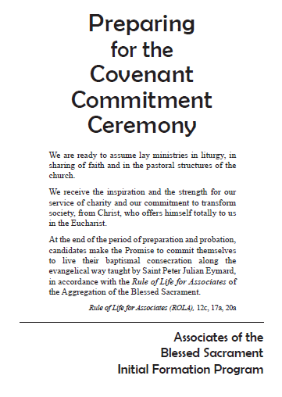

Slide 4
Preparing for the Covenant Commitment Ceremony
Leader: God of loving mercy,
to restore creation and to bring all people to intimacy with you,
you sent Jesus, your Son, into our world.
His mission was to reveal your love
and to build your rule of perfect justice and peace.

Slide 5
Preparing for the Covenant Commitment Ceremony
All: As we gather here for this time of reflection and prayer,
we accept our rightful share in Christ’s mission today.
He has no eyes but ours,
no ears but ours,
no hands but ours.
Use them to touch and heal our world.

Slide 6
Preparing for the Covenant Commitment Ceremony
Leader: In your love, you invite us to the table of the Eucharist which foretells the banquet of everlasting life and joy in your presence one day. In your love, you invite us to communion with you and one another. Bring us to love you and the world so much that we will give freely of ourselves for your glory and the good of all.

Slide 7
Preparing for the Covenant Commitment Ceremony
All:
Jesus said, “I have come to light a fire on the earth.”
Kindle in our hearts the fire of the Holy Spirit that our words will give you honor
and our deeds will help to bring about your reign on earth.

Slide 8
Preparing for the Covenant Commitment Ceremony
All:
We make this prayer
through Jesus Christ our Lord,
who gave his life out of love for the world
and lives with you and the Holy Spirit,
one God, forever and ever. Amen.

Slide 9
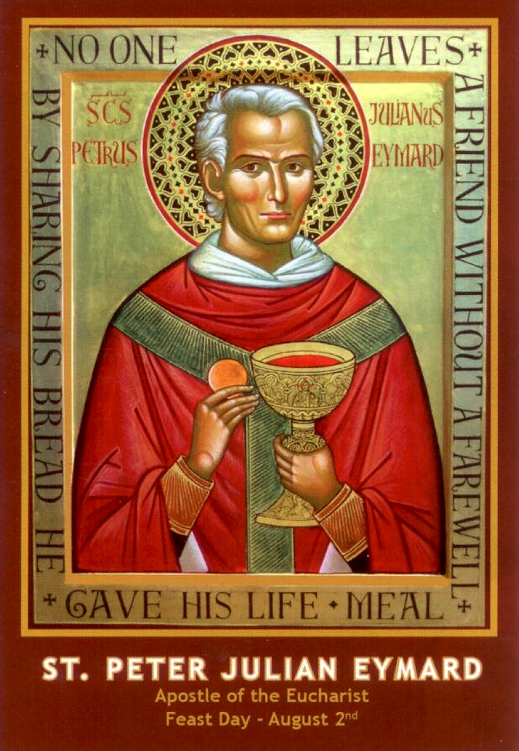
Introduction to the theme

Slide 10
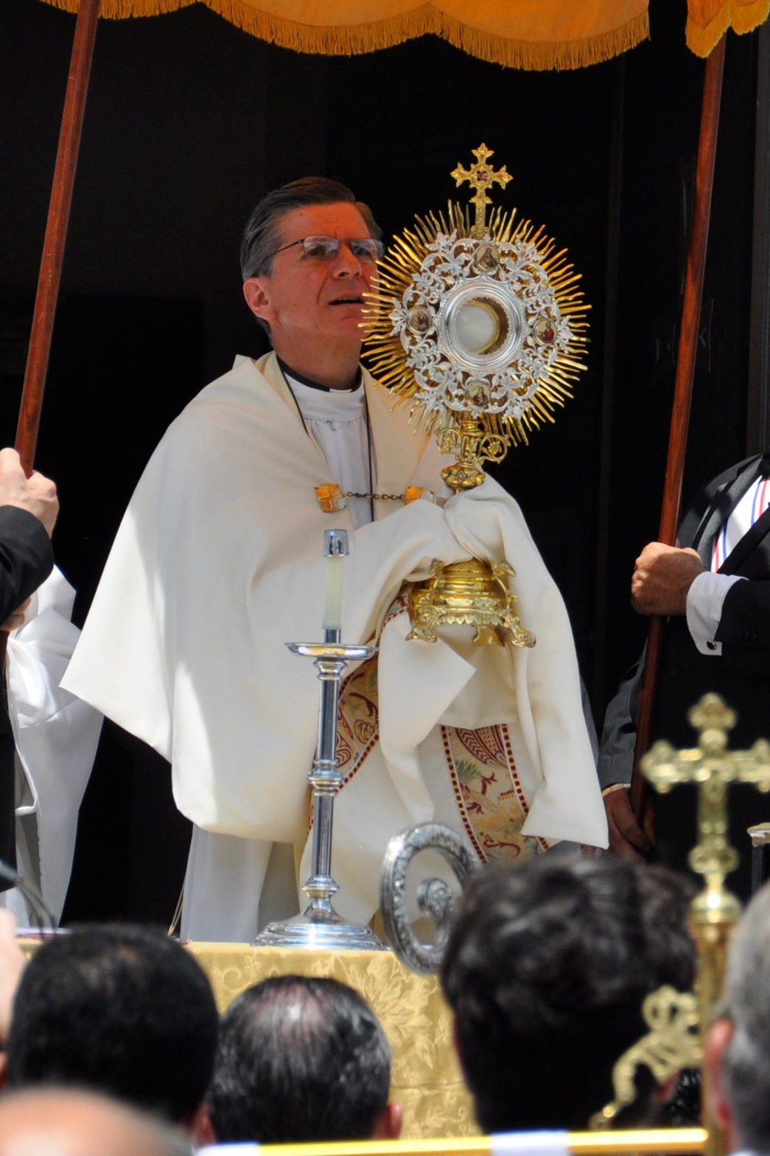

Slide 11
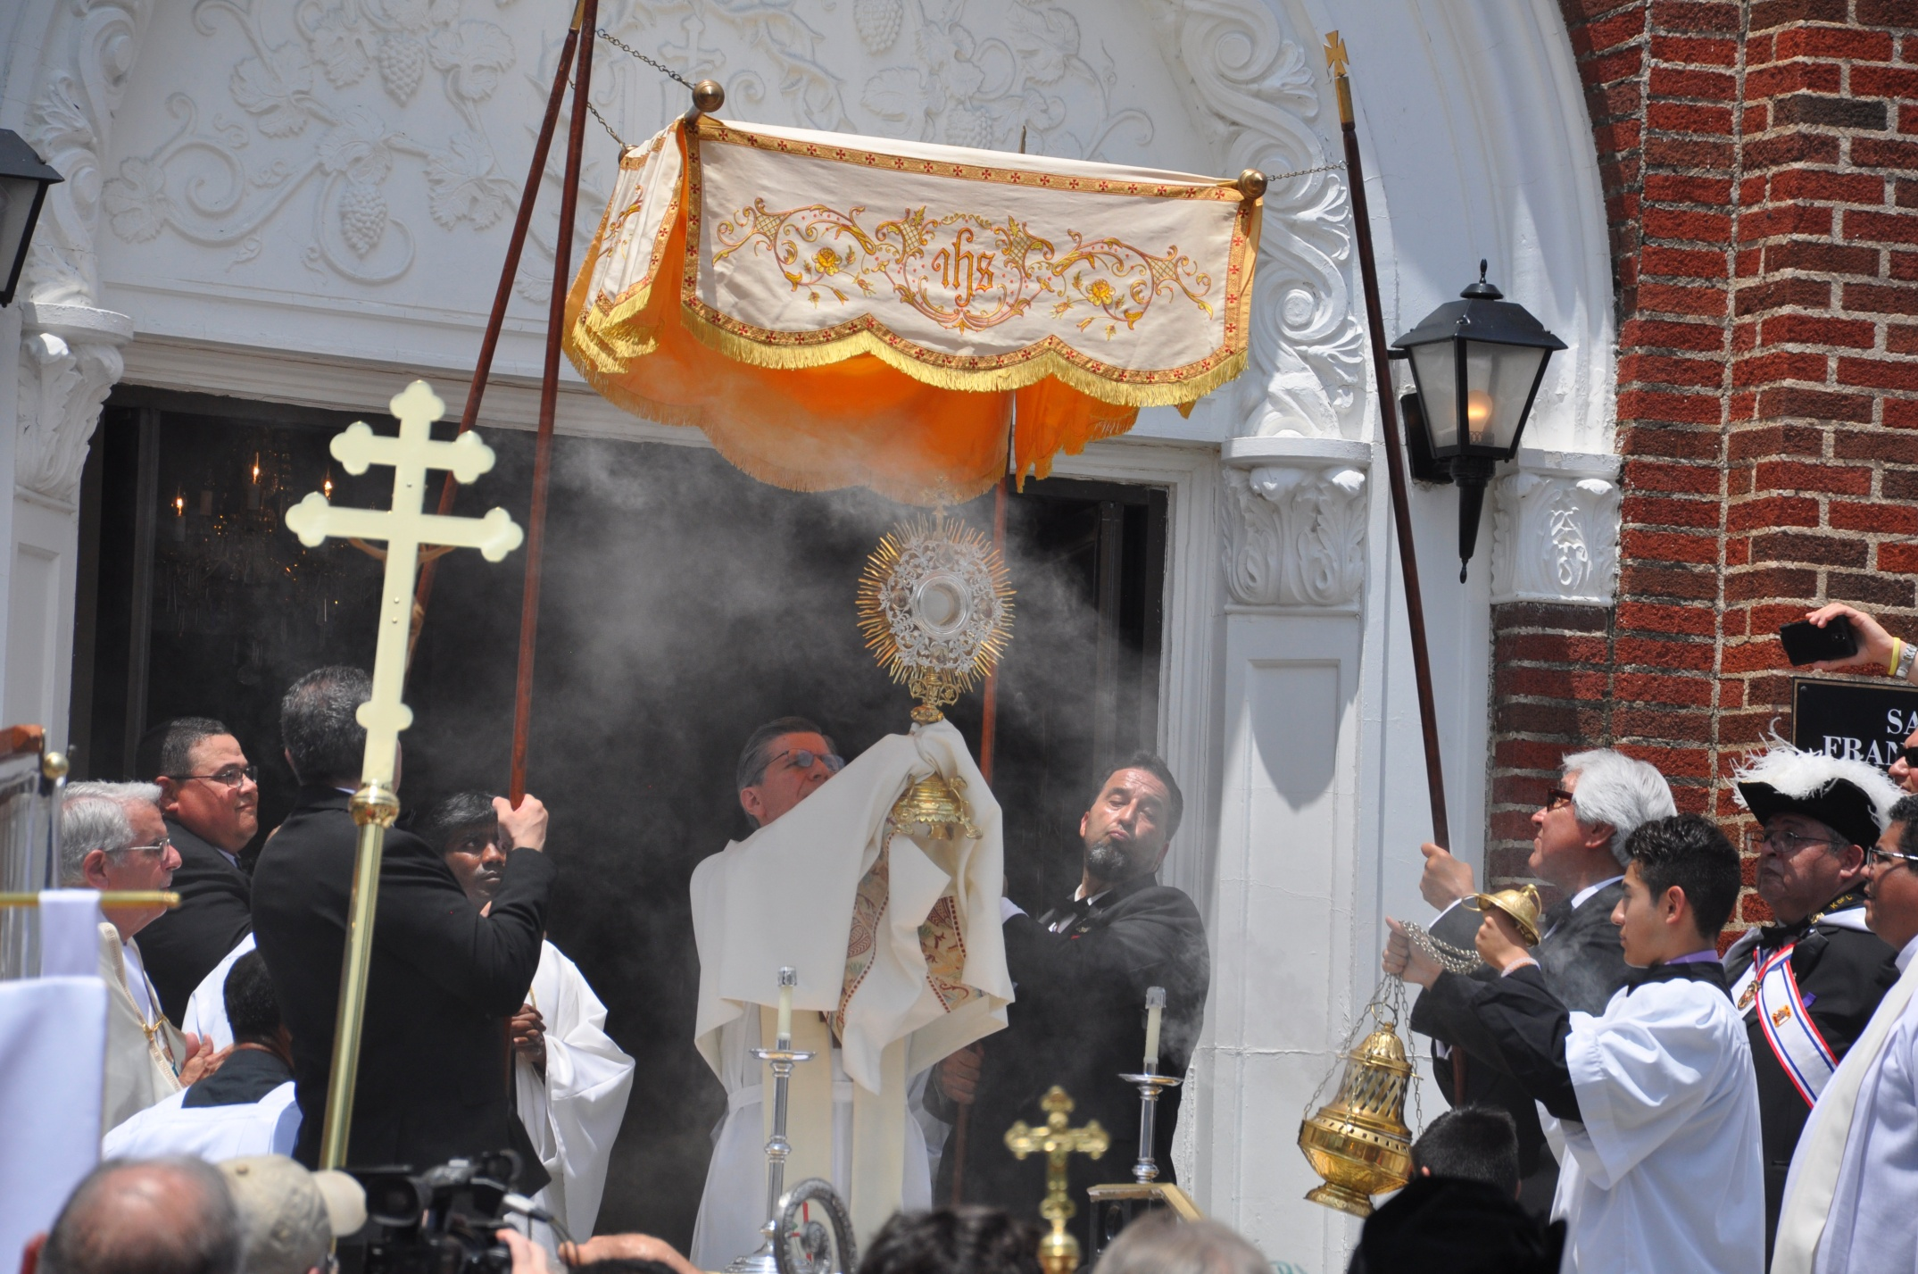

Slide 12
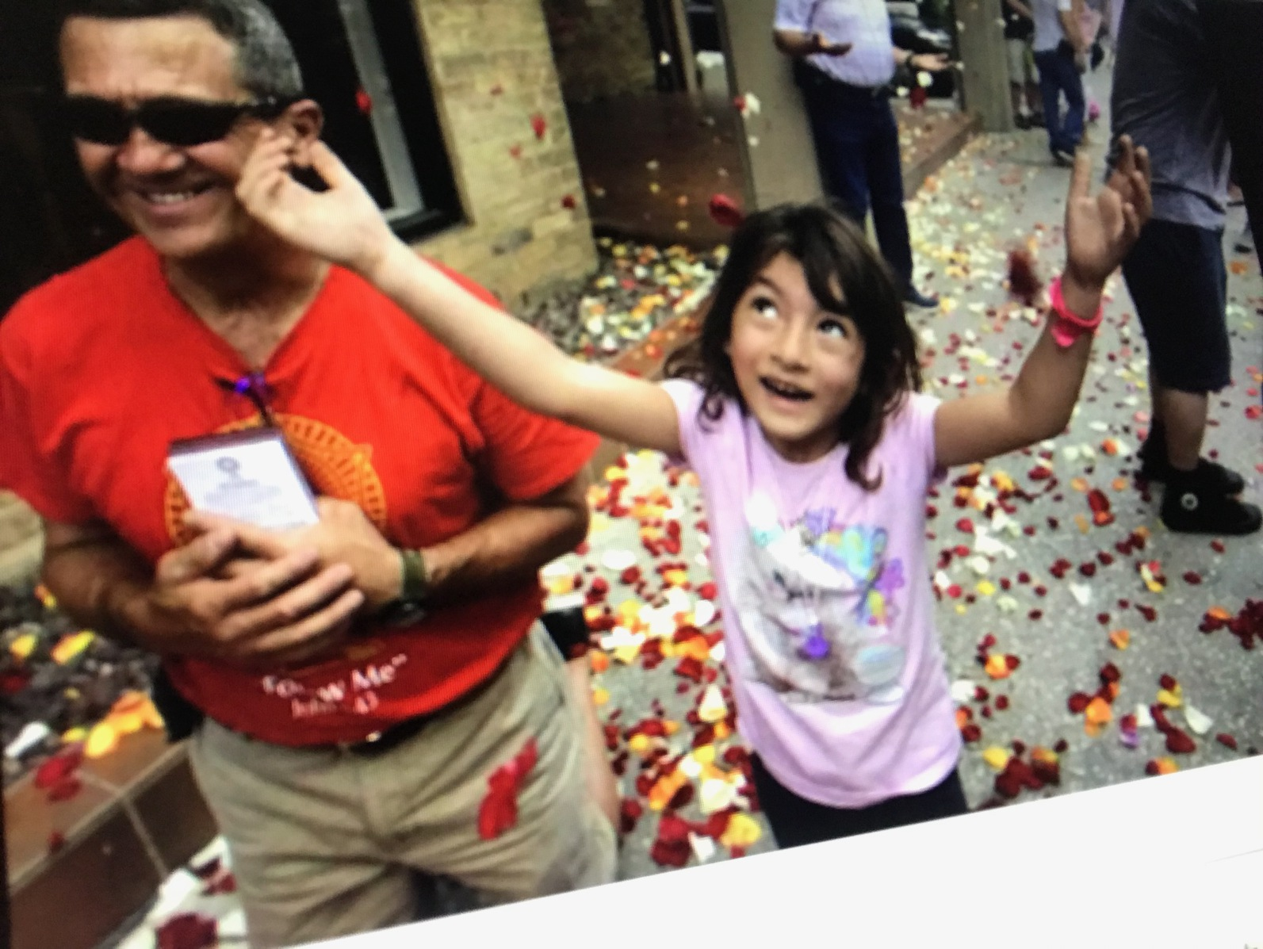

Slide 13
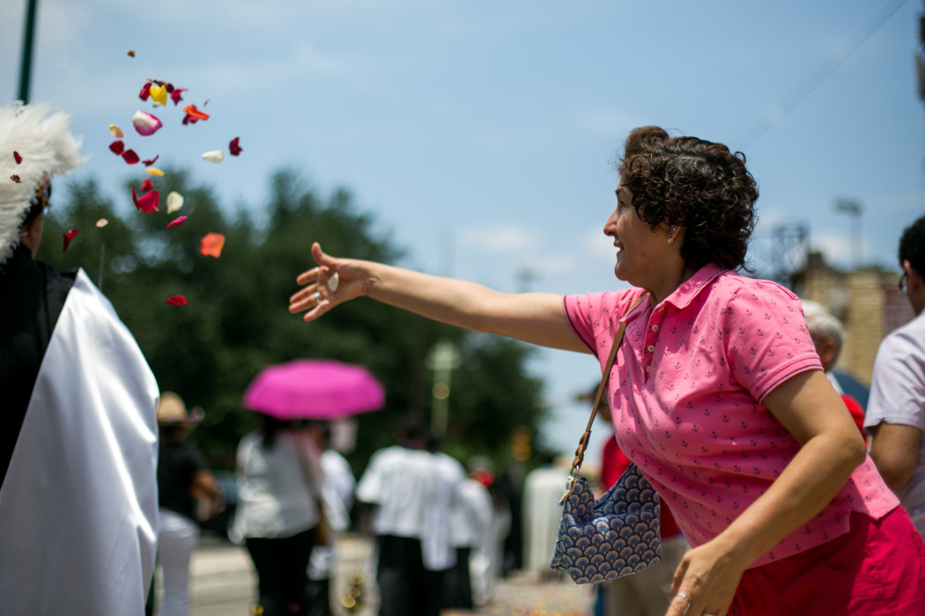

Slide 14
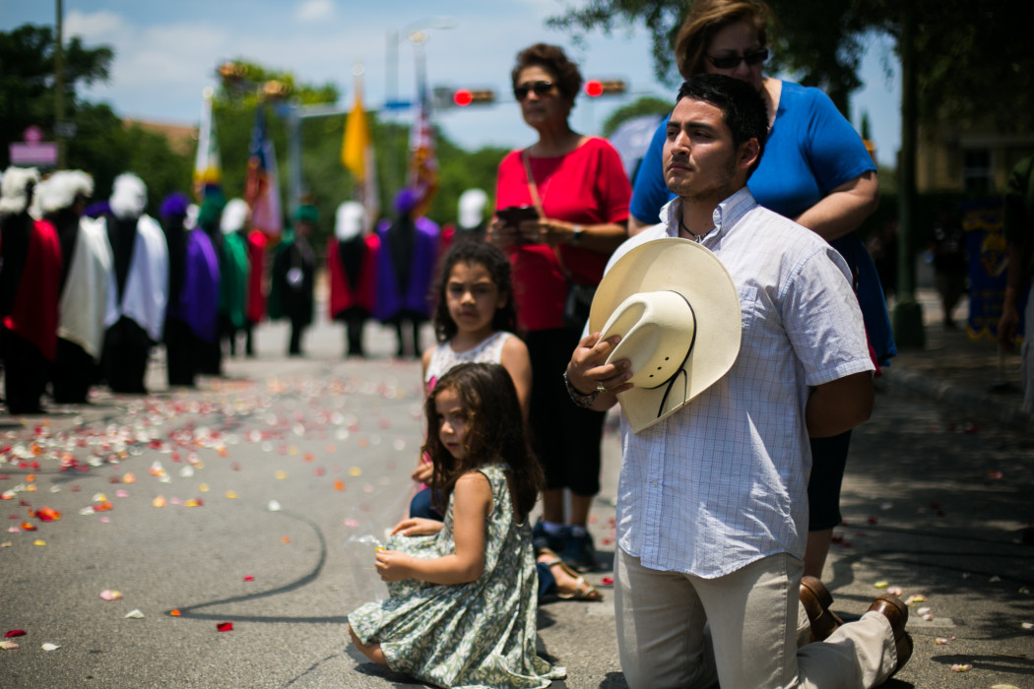

Slide 15
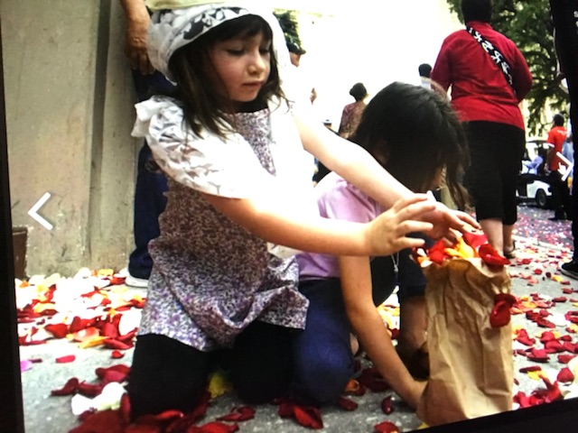

Slide 16
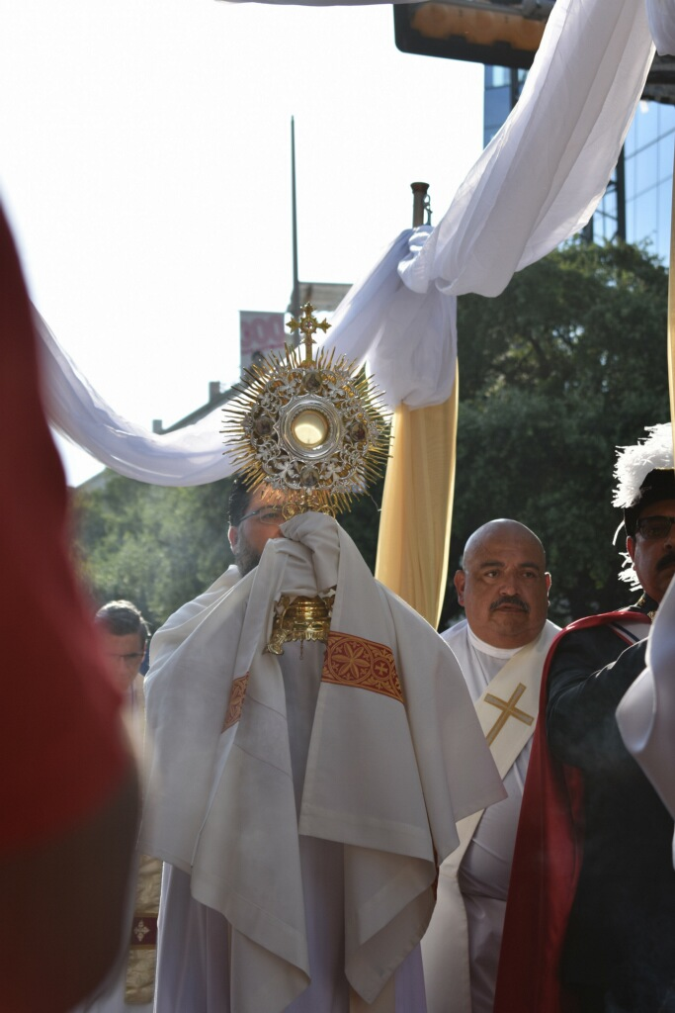

Slide 17
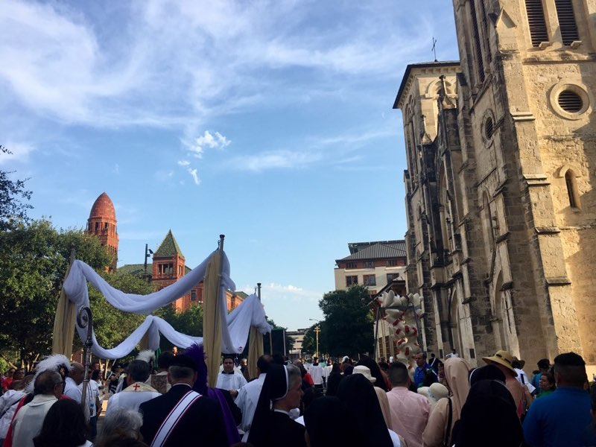

Slide 18
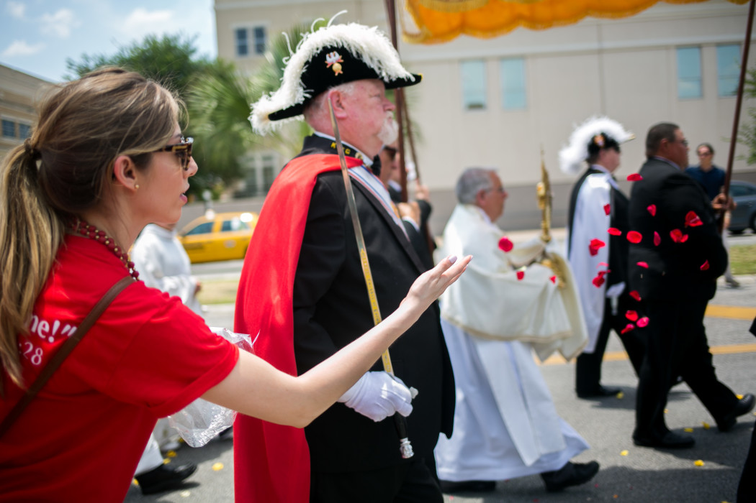

Slide 19
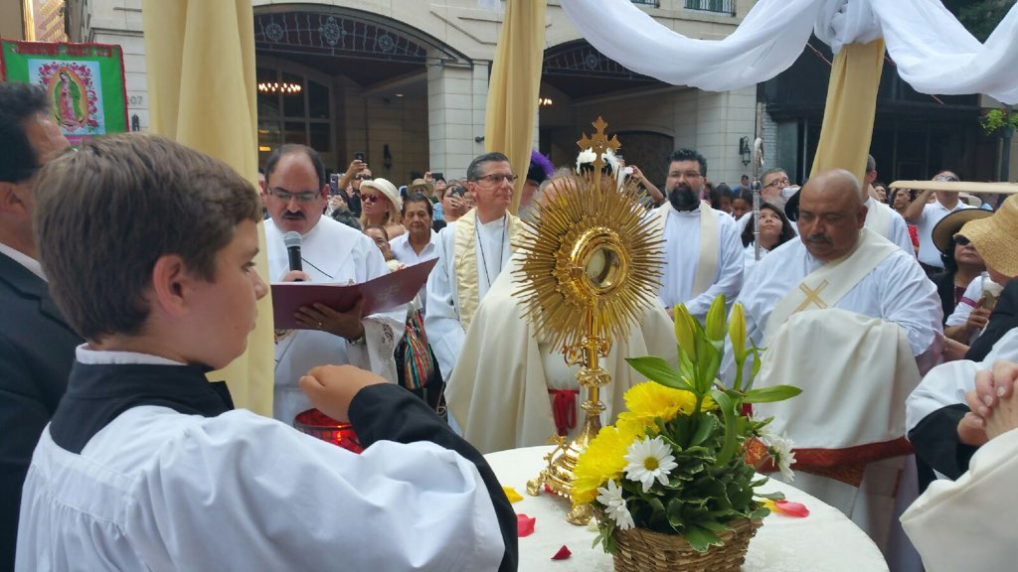

Slide 20
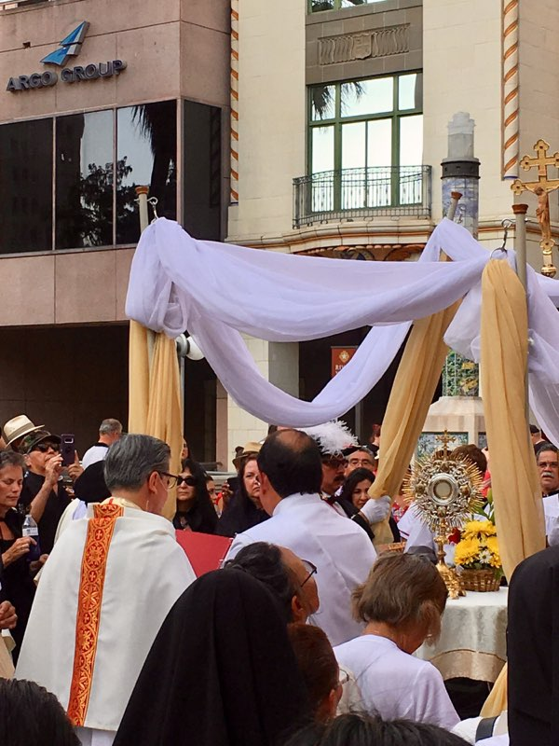

Slide 21
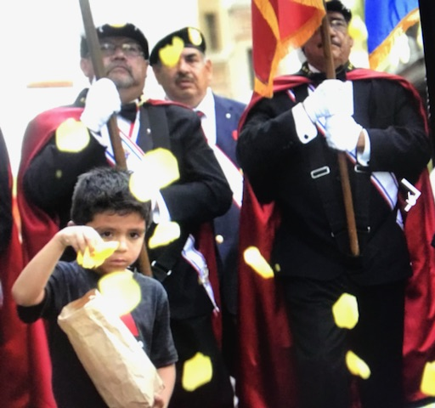

Slide 22
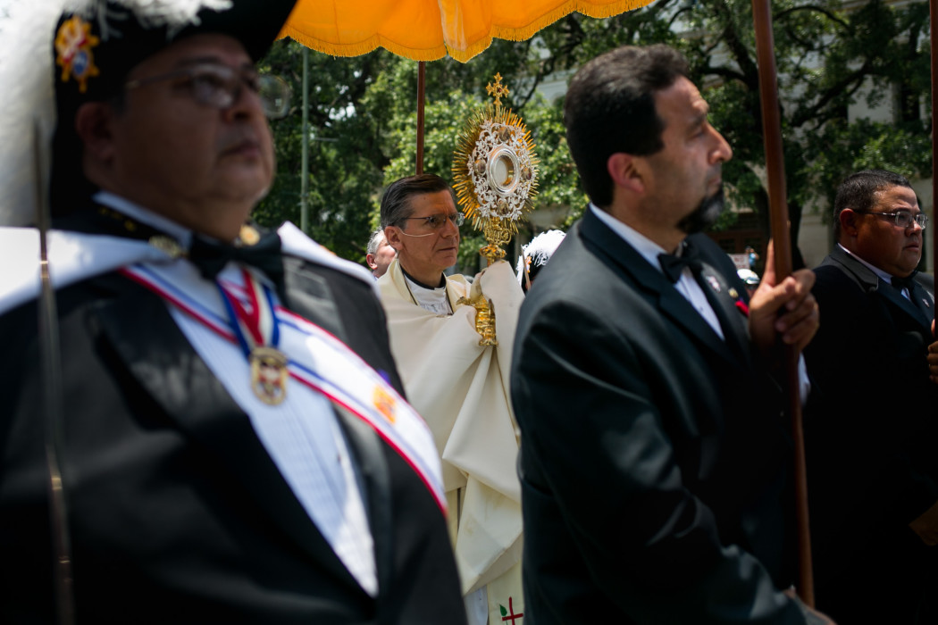

Slide 23
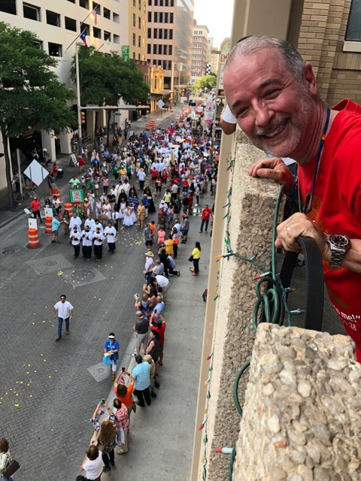

Slide 24
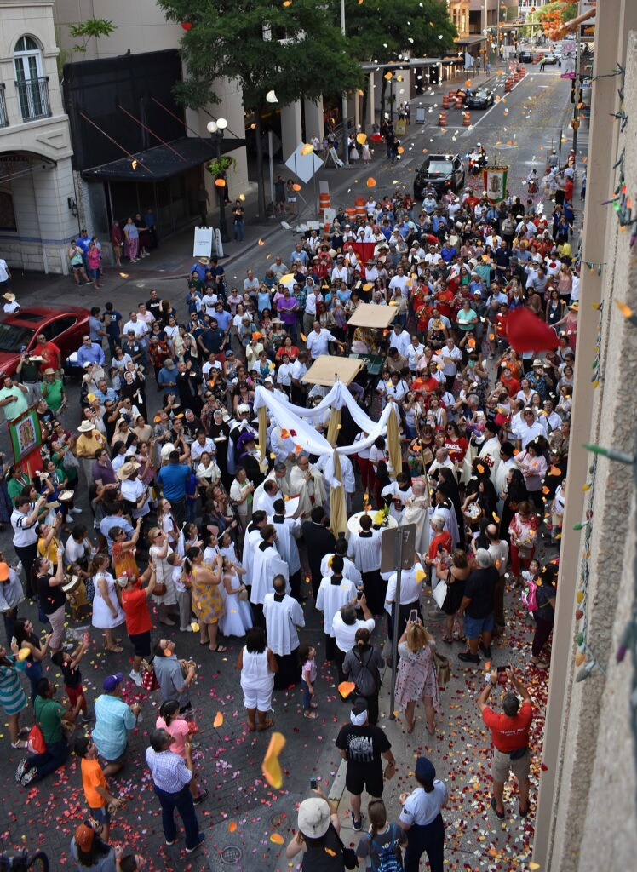

Slide 25
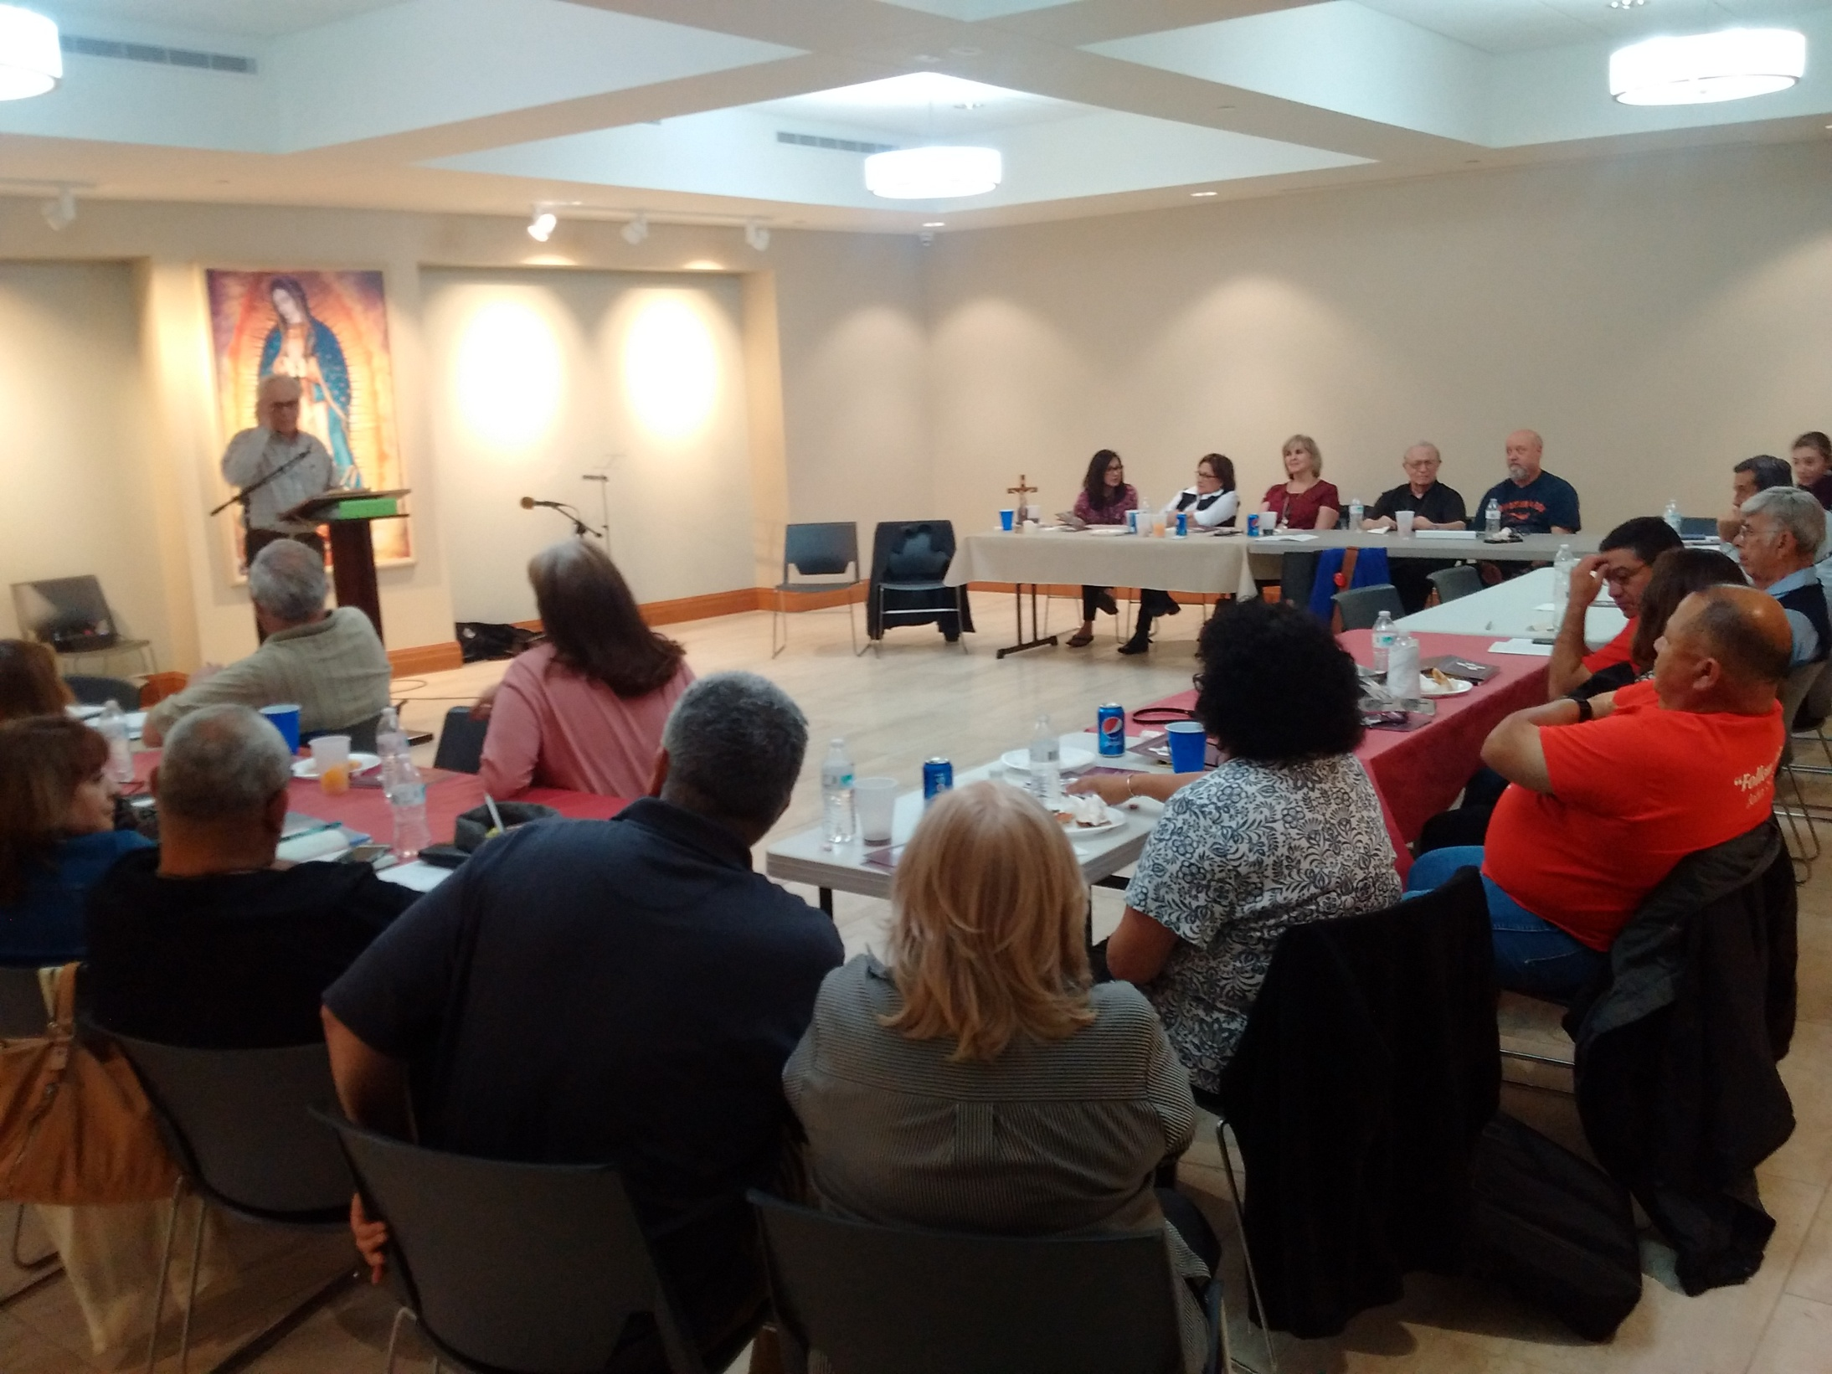

Slide 26
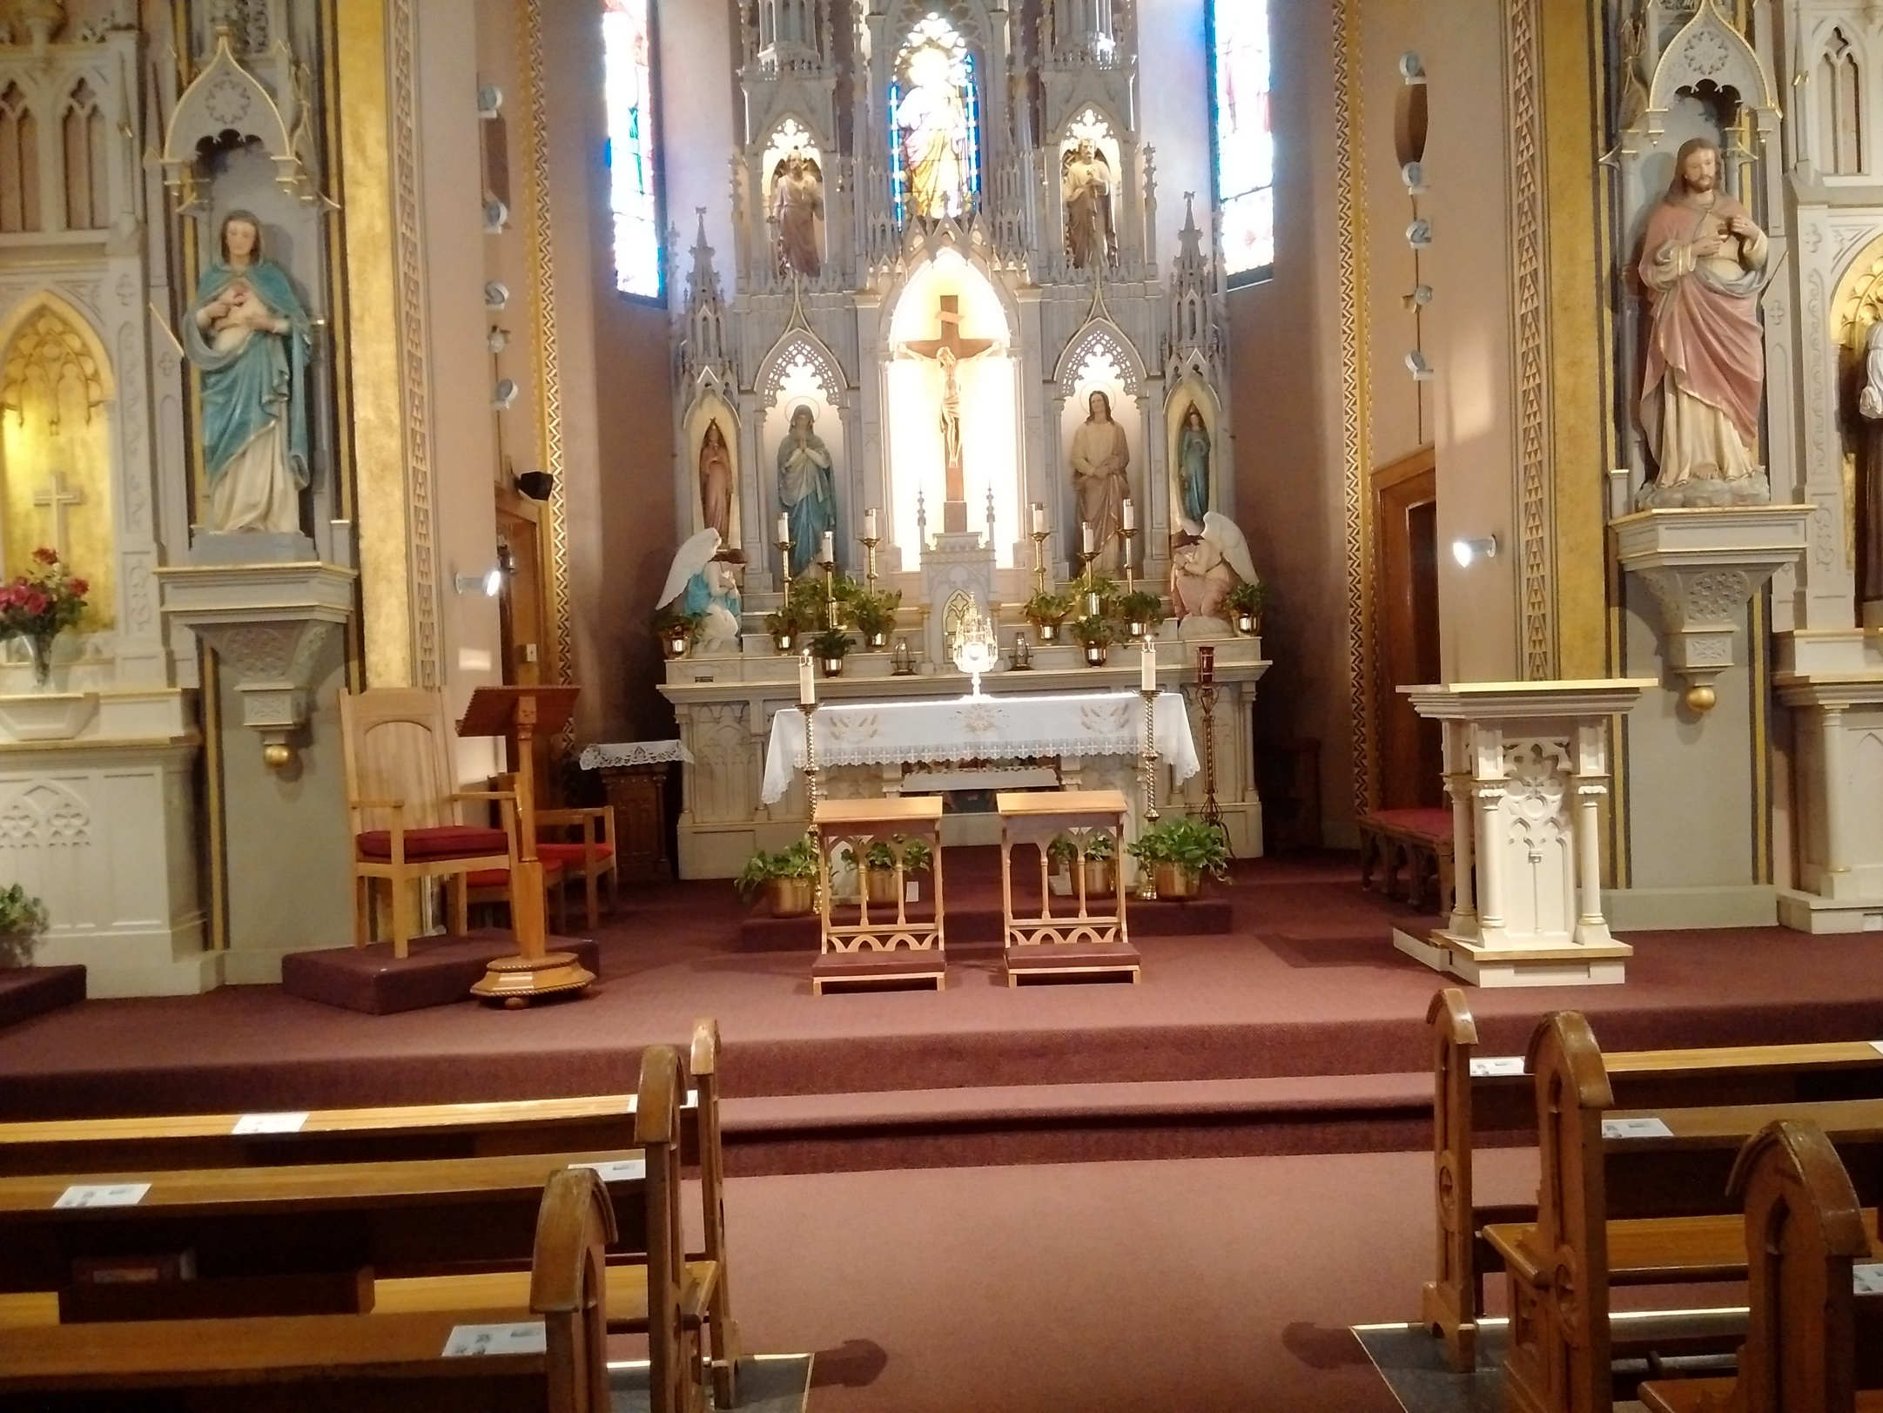

Slide 27
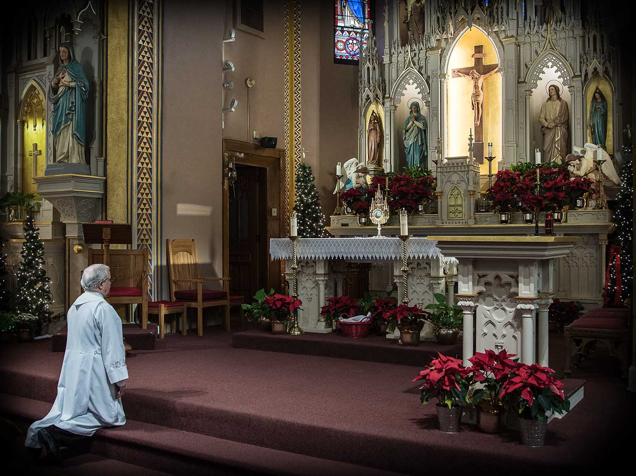

Slide 28
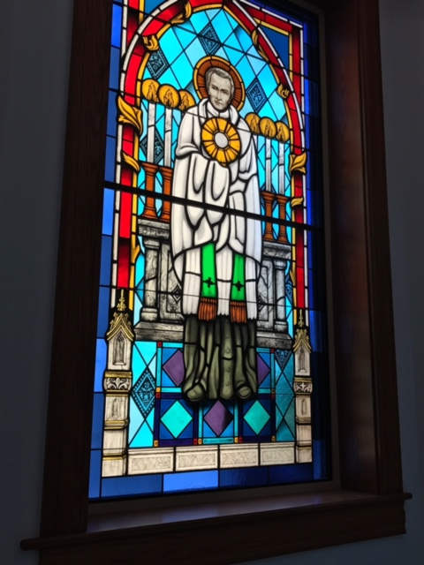

Slide 29
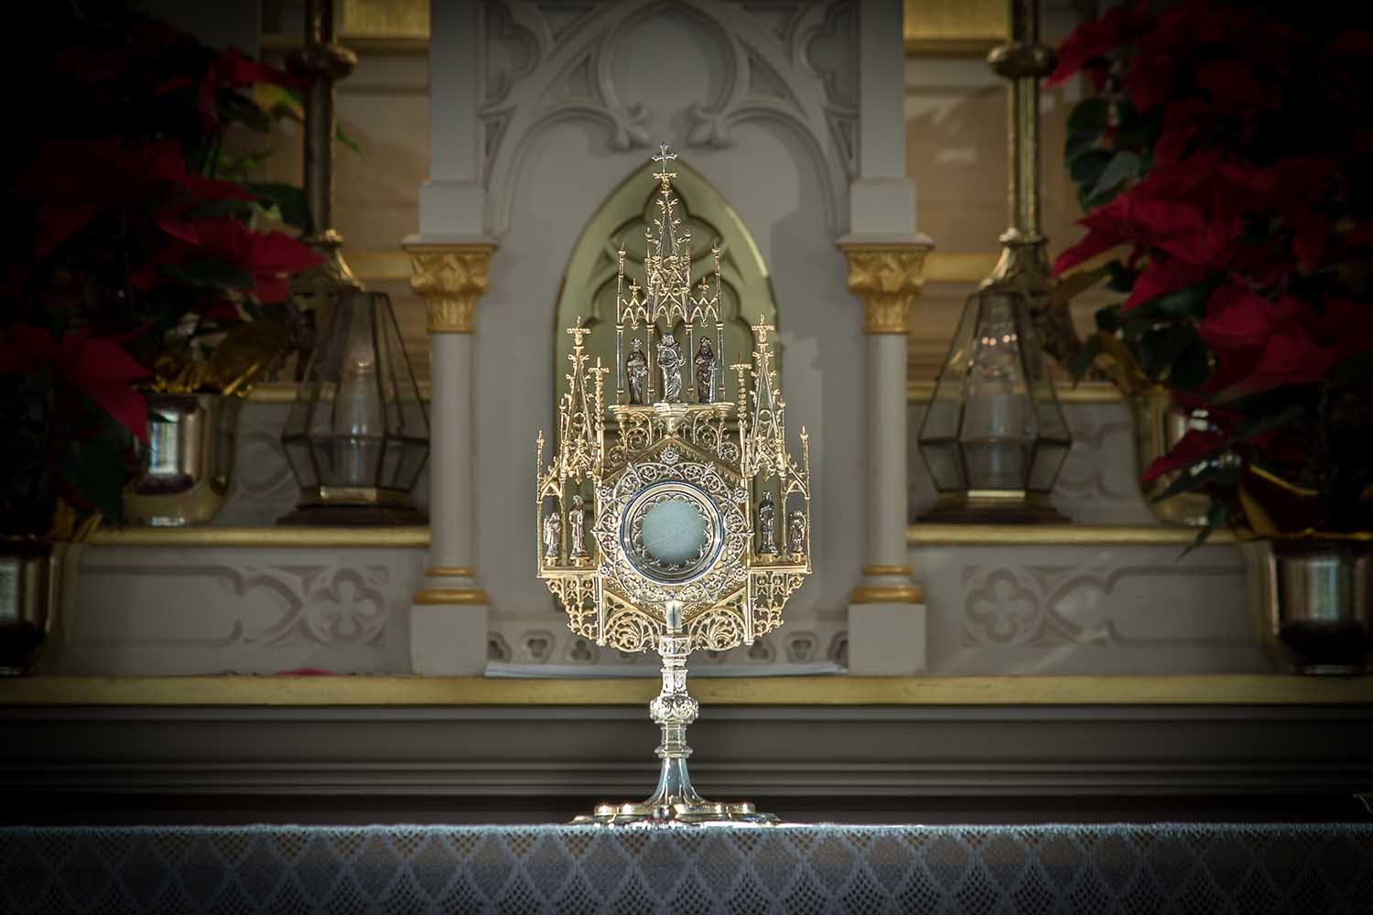

Slide 30
“Let us Love Jesus who loves us so much in his divine sacrament”

Slide 31
Closing Prayer
All: Saint Peter Julian,
the Lord has given you,
as he once did to Jacob, his servant,
an ever searching faith.
All your life long you have sought the way
to deepen your union with God
and to satisfy the hungers of humanity.

Slide 32
All: In the Eucharist you discovered the answer to your searching:
God’s love was there for you and for all humanity.
Answering this gift of love
you made the gift of yourself to God
and you have given of yourself to the service of his people
without counting.

Slide 33
All: Your life, modeled on that of the Cenacle, where Mary and the apostles were united in prayer.
Their apostolic zeal caused them to build Christian communities,
where the Eucharist is the center and the source of life.
Saint Peter Julian,
accompany us on our journey of faith.

Slide 34
All: May our ardent prayer and our generous service help us to contribute to the establishing of a world where there is justice and peace.
May our celebrations of the Eucharist
proclaim the liberating love of God
for the renewal of his church
and the coming of his kingdom. Amen.

Slide 35
Prayer in Honor of Saint Peter Julian Eymard
Gracious God of our ancestors, you led Peter Julian Eymard, like Jacob in times past, on a journey of faith. Under the guidance of your gentle Spirit, Peter Julian discovered the gift of love in the Eucharist which your Son Jesus offered for the hungers of humanity. Grant that we may celebrate this mystery worthily, adore it profoundly, and proclaim it prophetically for your greater glory. Amen.

